Slide 1

Parts of Speech
Building blocks of language
Presented By : GROUP-A
Abhay Kumar
Abhiraj Sagar
Abhishek
Abhishek Pal
Ajeet Singh

Slide 2
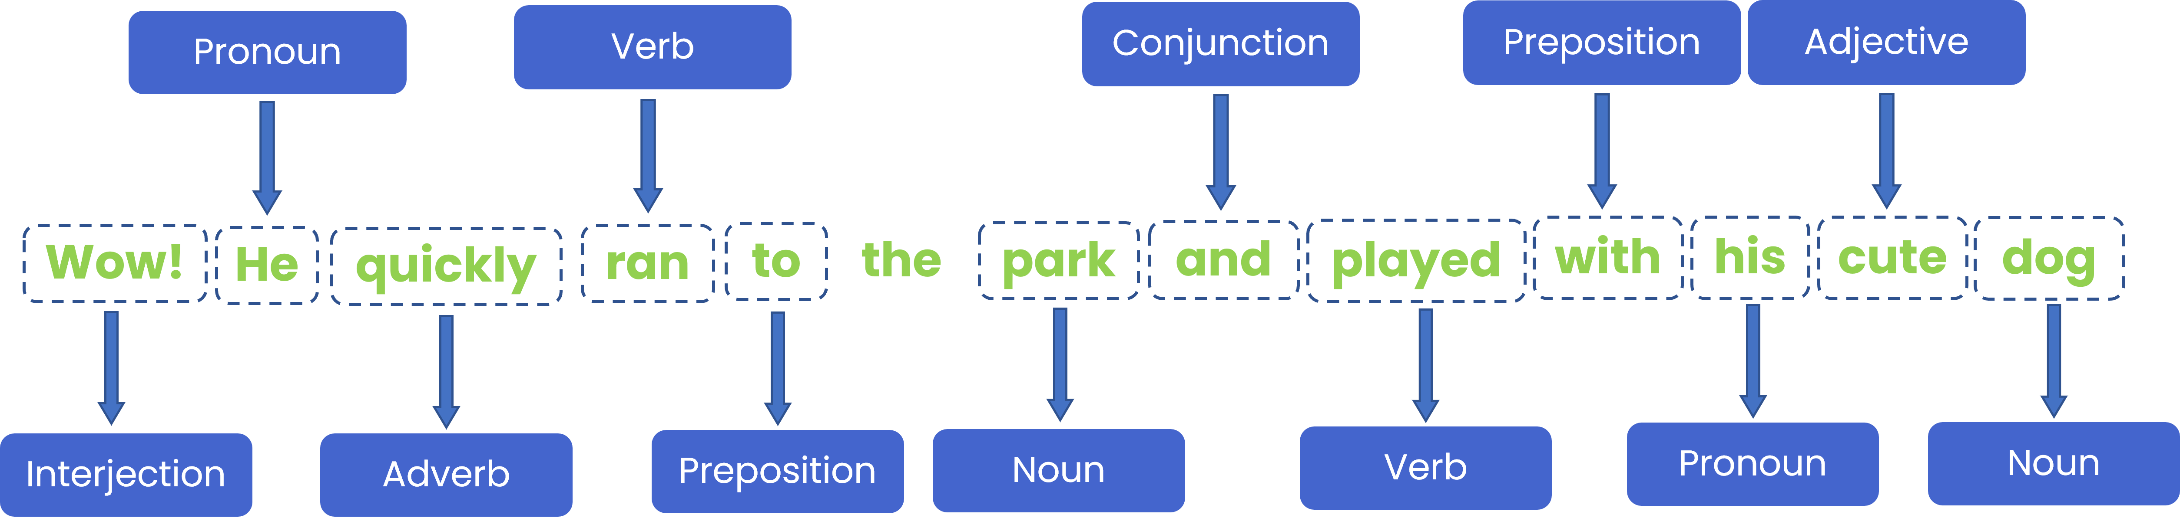
Parts of Speech
Parts of speech can be defined as the categories into which words are classified based on their roles and functions in a sentence.

Slide 3
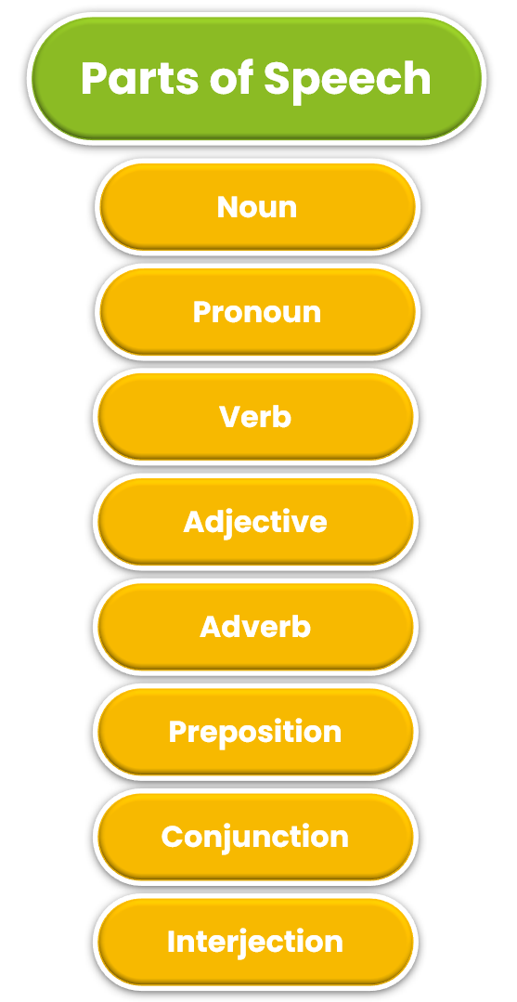
Classification of
Parts of Speech
Parts of speech are categorized into distinct groups based on the specific function & meaning each word serves within the structure of the sentence.

Slide 4




NOUN
Nouns are a part of speech that comprise words which are used to name people, places, animals or objects.
Thus, they are also known as Naming Words.
A noun may serve as Subject as well as Predicate in sentences.
PERSON
ANIMAL
Examples,
The cat sat on the chair.
This shop was robbed last night.
Steve came back from London.
Please open that window.
PLACE
OBJECTS

Slide 5
CLASSIFICATION OF NOUN
Nouns can further be classified into 9 categories based on their use in the sentence:
NOUN
PROPER NOUN
MATERIAL NOUN
COMMON NOUN
COMPOUND NOUN
COLLECTIVE NOUN
UNCOUNTABLE NOUN
ABSTRACT NOUN
COUNTABLE NOUN
CONCRETE NOUN

Slide 6


PROPER NOUN
A proper noun is a noun that represents a unique entity. They are used to name person, places, animals or things.
In Modern English, most proper nouns are written with first letter in capital case.
For example,
John went to Paris for vacation.
Mount Everest is the highest mountain in the world.
I visited Taj Mahal last summer.

Slide 7



COMMON NOUN
A common noun is a noun that is used to represent a class of entities (country, animal, language, person) instead of the unique entity like Proper Nouns.
These are used to refer to a generic item, group or place. In Modern English, common nouns are not capitalized unless they begin a sentence.
For example,
I bought a pen yesterday.
I am going to school.
That book is very interesting.

Slide 8





COLLECTIVE NOUN
A collective noun refers to a group of individuals, animals, or objects considered as one unit.
For example,
The crowd cheered loudly.
A herd of elephants was crossing the river.
The hive decided on the issue.

Slide 9



ABSTRACT NOUN
An abstract noun represents intangible ideas, qualities, feelings, or states that cannot be perceived by the senses.
For example,
His bravery was praised.
Honesty is valuable in today’s world.
Justice must be done for the victims.

Slide 10


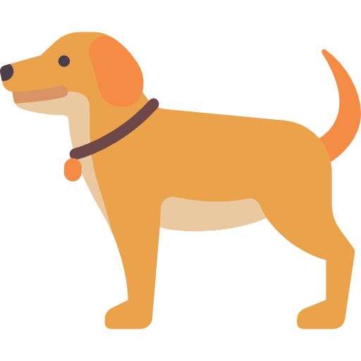
CONCRETE NOUN
A concrete noun refers to physical things that can be seen, touched, heard, smelled, or tasted.
For example,
I placed the book on the table.
The cake smells delicious.
A dog barked outside.

Slide 11



COUNTABLE NOUN
A countable noun refers to things that can be counted individually.
For example,
I have three apples.
The students were happy.
There are four seasons.

Slide 12



UNCOUNTABLE NOUN
An uncountable noun refers to things that cannot be counted individually and are measured in quantity.
For example,
There is water in the glass.
He threw out the garbage.
She gave me some useful information.

Slide 13


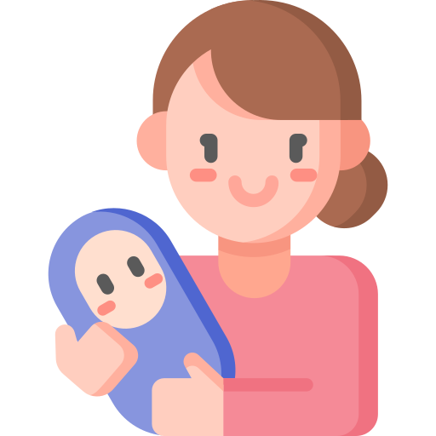
COMPOUND NOUN
A compound noun is made up of two or more words combined to form a single noun.
For example,
The toothbrush is in the bathroom.
She is a software-engineer.
The mother-in-law arrived yesterday.

Slide 14



MATERIAL NOUN
A material noun refers to substances or materials from which things are made.
For example,
This ring is made of gold.
The chair is made of wood.
Cotton is a soft fabric.

Slide 15


PRONOUN
Pronouns are a part of speech that are used to substitute nouns in a sentence to make it clearer and concise.
They are used to prevent repetition of the noun words.
The meaning of the pronouns is mostly dependent on an antecedent.
SUBSTITUE NOUNS
Examples,
It is a good idea.
I know the people who work here.
He is intelligent.
They are very friendly.
PREVENTS REPETITION

Slide 16
CLASSIFICATION OF PRONOUNS
Pronouns can further be classified into the following 11 categories based on their functions:
INTENSIVE
PRONOUNS
PRONOUNS
RECIPROCAL PRONOUNS
RELATIVE PRONOUNS
OBJECT
PRONOUNS
POSSESSIVE PRONOUNS
SUBJECT
PRONOUNS
REFLEXIVE PRONOUNS
PERSONAL
PRONOUNS
DEMONSTRATIVE PRONOUNS
INDEFINITE PRONOUNS
INTERROGATIVE PRONOUNS

Slide 17



INTENSIVE PRONOUNS
Intensive pronouns are used to emphasize a noun or another pronoun in the sentence.
For example,
The manager himself approved the proposal.
I will do it myself if no one else can.
She herself solved the problem without any help.

Slide 18



RELATIVE PRONOUNS
Pronouns which is used to relate one part of the sentence to another part of the sentence are called relative pronouns.
For example,
The car which you bought is very fast.
I have a friend who loves painting.
This is the book that I was looking for.

Slide 19



POSSESSIVE PRONOUNS
Pronouns which are used to express possession of a certain entity are called possessive pronouns.
For example,
The gift is hers.
The house on the corner is ours.
Is this pen yours?

Slide 20



REFLEXIVE PRONOUNS
Reflexive pronouns are pronouns that refer back to the subject of the sentence.
They are used when the subject and the object of the sentence are the same person or thing.
For example,
She did the homework by herself.
I cut myself while chopping vegetables.
He looked at himself in the mirror.

Slide 21


DEMONSTRATIVE PRONOUNS
These pronouns are used to point to specific objects. They indicate which one(s) are being referred to based on their location from the speaker.
For example,
This is my favourite book.
I want those shoes.
These are the best cookies I’ve ever had.

Slide 22



INTERROGATIVE PRONOUNS
Pronouns which are used to ask questions are referred to as Interrogative Pronouns.
For example,
Who is coming to the party?
What did you have for dinner?
Which one do you prefer?

Slide 23



INDEFINITE PRONOUNS
Indefinite pronouns are pronouns that refer to non-specific people or things. They do not point to a particular noun and are used when the exact identity is unknown or not important.
For example,
Someone left their umbrella here.
Everybody likes a good story.
Nothing is faster than light.

Slide 24



PERSONAL PRONOUNS
These pronouns are the pronouns which are used to substitute proper names in the sentences.
For example,
He is a talented guy.
She went to the store.
They are playing soccer in the park

Slide 25



SUBJECT PRONOUNS
The pronouns which performs actions in a sentence are called subject pronouns.
For example,
I love to read books.
They are going to the concert.
We need to finish the project by tomorrow.

Slide 26



OBJECT PRONOUNS
Pronouns which receive the action in a sentence are referred to as object pronouns. They are used to substitute the object in a sentence.
For example,
He gave the book to me.
Can you help him with the homework?
They invited us to their party.

Slide 27



RECIPROCAL PRONOUNS
Pronouns that are used to express a mutual relationship. They are mostly used when two or more people or things perform an action on each other.
For example,
They gave each other gifts for Christmas.
The two friends hugged one another after years of separation.
We should respect each other in every situation.

Slide 28



VERBS
Verbs are used to express actions, occurrences, or states of being.
They are essential for forming sentences and conveying meaning by describing what the subject is doing, what is happening, or how the subject exists.
WHAT IS HAPPENING ?
Examples,
She runs every morning to stay fit.
The sky is clear and bright today.
They have completed the project ahead of schedule.
He feels tired after the long hike.
EXPRESSES ACTION
WHEN IT HAPPENED ?

Slide 29
CLASSIFICATION OF VERBS
Verbs can further be classified into the following categories based on the kinds of words that accompany it (verb) and the relationship those words have with the verb itself:
INTRANSITIVE
VERBS
VERBS
COPULAR
VERBS
TRANSITIVE
VERBS
DITRANSITIVE
VERBS

Slide 30

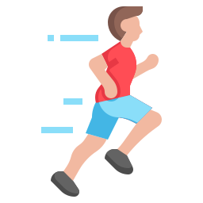

INTRANSITIVE VERBS
An intransitive verb is one that does not have a direct object. Intransitive verbs may be followed by an adverb or end a sentence.
For example,
The guy spoke loudly.
The kid ran faster than the teachers.
The boy wept.

Slide 31
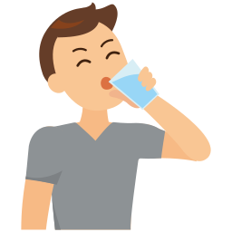


TRANSITIVE VERBS
Transitive verbs are the verbs that require a direct object to complete their meaning. The action of a transitive verb is done to someone or something.
For example,
The newspaper was read by my friend.
A speeding ticket was earned by the teenager.
He drank the water.

Slide 32



DITRANSITIVE VERBS
These verbs precede either two noun phrases or a noun phrase and then a prepositional phrase often led by to or for.
For example,
The players gave their teammates high fives.
They sent their friend an invitation.
I bought my sister a birthday cake

Slide 33
COPULAR VERBS
Copular verbs are verbs that connect the subject of a sentence to a subject complement (such as a noun, pronoun, or adjective) that provides more information about the subject.
For example,
She is a doctor.
The soup tastes delicious.
He became tired after the long trip.

Slide 34



ADJECTIVE
An adjective is a word that describes, defines, or qualifies a noun or noun phrase by providing additional information about its attributes, such as size, shape, colour, origin, material, quality, quantity, or state.
Adjectives often answer questions like which one, what kind or how many.
ATTRIBUTES OF NOUN
EXPRESSES QUALITY
Examples,
The beautiful garden was full of flowers.
He wore blue jacket.
That book is heavy.
ADDITIONAL INFO

Slide 35
CLASSIFICATION OF ADJECTIVES
Adjective can further be classified into the following categories based on their use:
ADJECTIVES
PREPOSITIVE
ADJECTIVES
NOMINALIZED
ADJECTIVES
POSTPOSITIVE
ADJECTIVES

Slide 36



PREPOSITIVE ADJECTIVES
These are also called attributive adjectives. These adjectives come before the noun they modify, which is the most common placement of an adjective in the English Language.
For example,
He was wearing leather boots.
They live in a small town.
He is a brave guy.

Slide 37

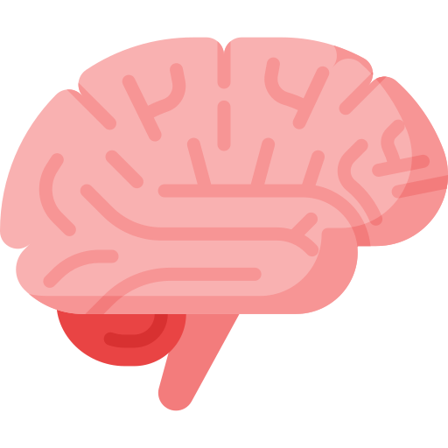

POSTPOSITIVE ADJECTIVES
These adjectives come after the noun they modify.
For example,
Is there anything special in the box?
We need someone intelligent for this.
Nothing important happened today.

Slide 38


NOMINALIZED ADJECTIVES
These adjectives act as nouns and usually refer to groups, abstract ideas, or categories.
For example,
The rich should help the poor.
The brave was honoured for their courage.
He appreciates the unknown in life.

Slide 39
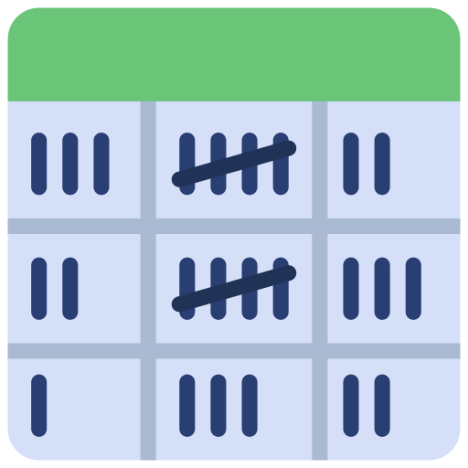


ADVERB
An adverb is a word or an expression that generally modifies a verb, an adjective or another adverb in a sentence.
Adverbs typically express manner, place, time, frequency, degree, or level of certainty by answering questions such as how, in what way, when, where, to what extent.
FREQUENCY
Examples,
She sang loudly.
We left it here.
I worked yesterday.
You often make mistakes.
TIME
PLACE

Slide 40
CLASSIFICATION OF ADVERBS
Adverbs can further be classified as follows based on their use in the sentence:
ADVERBS OF MANNER
ADVERBS
RELATIVE ADVERBS
ADVERBS OF TIME
INTERROGATIVE ADVERBS
ADVERBS OF PLACE
ADVERBS OF FREQUENCY
ADVERBS OF REASON
ADVERBS OF DEGREE

Slide 41



ADVERBS OF MANNER
The adverbs which describe how an action is performed are referred to as adverbs of manner.
For example,
He sings beautifully.
He answered the question confidently.
The dog ran quickly.

Slide 42



ADVERBS OF TIME
The adverbs which indicate the time of an action are referred to as adverbs of time.
For example,
I will call you tomorrow.
I will finish cleaning tonight.
Do it as soon as possible.

Slide 43



ADVERBS OF PLACE
The adverbs which describes the place of the action are called adverbs of place.
For example,
She looked everywhere for her keys.
The children are playing outside.
He walked towards the door.

Slide 44



ADVERBS OF DEGREE
The adverbs which express the intensity or extent of an action or quality.
For example,
The movie was extremely interesting.
She is quite talented at painting.
The cake is too sweet for my taste.

Slide 45



ADVERBS OF FREQUENCY
The adverbs which indicates how often an action happens.
For example,
I always drink coffee in the morning.
They rarely go out on weekdays.
He visits us twice a year.

Slide 46



ADVERBS OF REASON
The adverbs which describes the reason for the action are called adverbs of reason.
For example,
I was sick yesterday, therefore, I took a leave.
The project was delayed, so we need more time.
She forgot the report, hence the delay.

Slide 47

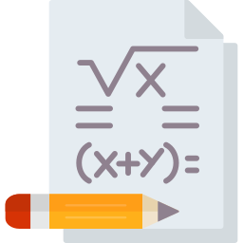

INTERROGATIVE ADVERBS
These are used to ask questions about an action or situation.
For example,
Why are you late?
How did you solve that problem?
When will the meeting start?

Slide 48

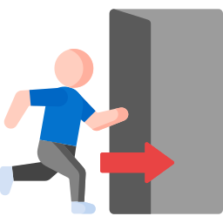

RELATIVE ADVERBS
These adverbs introduce a clause that provides more information about a time, place or reason.
For example,
The house where I grew up is now for sale.
The reason why he left is unknown.
Do you know the city where he live?

Slide 49

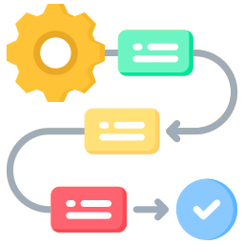
PREPOSITION
A preposition is a short word that is employed in sentences to show the relationship nouns, pronouns or phrases have with other parts within the respective sentences.
Prepositions are normally found positioned in the latter part of the sentence, but before a noun or pronoun.
PLACE
DIRECTION
Examples,
I will be going to church in the morning.
She placed the plates on the dining table.
The store is right in front of the bus stop.
He travels by train
METHOD

Slide 50
CLASSIFICATION OF PREPOSITIONS
Based on the different uses and functions of prepositions, they can be divided into the following categories:
PREPOSITIONS OF TIME
PREPOSITIONS
PREPOSITIONS OF PLACE
PREPOSITIONS OF DIRECTION
PREPOSITIONS OF SPATIAL RELATIONSHIPS
PREPOSITIONS OF LOCATION

Slide 51



PREPOSITION OF TIME
Prepositions which are used to show when something is happening.
For example,
We will be meeting on Friday.
The supermarket will be closed from 9PM to 9AM.
Can you come after some time?

Slide 52



PREPOSITION OF PLACE
Prepositions which are used to indicate the place of something.
For example,
I have kept the book on the table.
Henry hid behind the door.
The dog jumped over the fence.

Slide 53



PREPOSITION OF DIRECTION
Prepositions which are used to denote the direction in which something travels or moves.
For example,
The girl ran towards her father.
Jerry jumped into the river.
Vicky passed the book to Sumit.

Slide 54



PREPOSITION OF LOCATION
Prepositions which are used to indicate the location of a particular object.
For example,
Amit would be staying at his cousin’s place for the weekend.
Make sure to keep the weights back in place after exercise.
I lay on the floor for a really long time.

Slide 55



PREPOSITION OF SPATIAL RELATIONSHIP
Prepositions used to denote an object’s movement away from the source and towards a source.
For example,
Nitin sat leaning against the wall.
The circus was stationed opposite the children’s park.
My brother and me spent the evening around the lake.

Slide 56



CONJUNCTION
A conjunction is a word used to connect clauses or sentences or to coordinate words within the same clause.
Conjunctions are essential in joining different ideas and making the sentence more fluid and meaningful.
CONCISER
CONNECT CLAUSES
Examples,
I want to go to the park, but it’s raining.
He is studying hard and he is practicing too.
We couldn’t find the book, so we went home.
He’s learning French because of his job.
FLUIDITY

Slide 57
CLASSIFICATION OF CONJUNCTIONS
Based on the different uses and functions of conjunctions, they can be divided into the following main types:
CONJUNCTIONS
COORDINATING CONJUNCTIONS
CORRELATIVE CONJUNCTIONS
SUBORDINATING CONJUNCTIONS

Slide 58





COORDINATING CONJUNCTIONS
These connect words, phrases, or independent clauses of equal importance.
For example,
I like coffee and tea.
He is smart but lazy.
We can leave now or wait for him.

Slide 59



SUBORDINATING CONJUNCTIONS
These connect an independent clause with a dependent clause, showing the relationship between the two.
For example,
I will call you when I arrive.
Because it’s raining, we stayed inside.
She didn’t come although she was invited.

Slide 60



CORRELATIVE CONJUNCTIONS
These work in pairs to connect equal elements within a sentence.
For example,
He is either at home or at work.
Neither the manager nor the assistant was available.
You must not only study hard but also practice regularly.

Slide 61

INTERJECTION
An interjection is a word or phrase that expresses a strong emotion or reaction, often standing alone.
It is usually followed by an exclamation mark, though it can be used in less forceful expressions with a comma.
Examples,
Wow! That’s an amazing performance.
Oh no! I forgot my keys.
Hurray! We won the game.
Oops! I didn’t mean to spill the water.
EXPRESS EMOTIONS

Slide 62
CLASSIFICATION OF INTERJECTIONS
Based on the different uses and functions of interjections, they can be divided into the following main types:
INTERJECTIONS
EXCLAMATORY INTERJECTIONS
GREETING
INTERJECTIONS
MILD
INTERJECTIONS

Slide 63

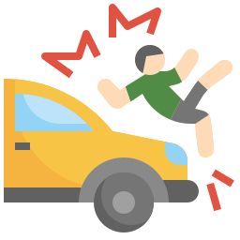

EXCLAMATORY INTERJECTIONS
These express strong emotions such as surprise, joy, or anger.
For example,
Wow! That’s great.
Yikes! That was bad.
Alas! I lost my wallet.

Slide 64



MILD INTERJECTIONS
These express a less intense emotion, such as hesitation or thoughtfulness.
For example,
Hmm, I’ll have to think about it.
Oh, I ate it.
Ew, that’s gross.

Slide 65



GREETING INTERJECTIONS
These are used to get someone’s attention or greet someone.
For example,
Hey! How are you doing?
Hi! It’s nice to meet you.
Look! There’s a rainbow.

Slide 66
THANK YOU

